Slide 1
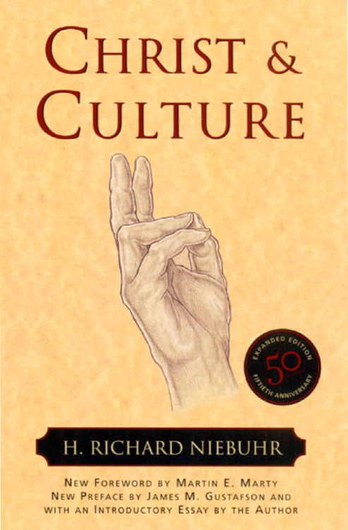
Christ and Culture
Session 24
Dr. Lewis Winkler • East Asia School of Theology (Singapore) Uploaded by Dr. Rick Griffith • Jordan Evangelical Theological Seminary Files in many languages for free download at BibleStudyDownloads.org

Slide 2
Introduction:
Why our approach to and understanding of Christ and culture matters so much

Slide 3
Introduction:
It impacts what we expect of culture and its relationship to Christianity in general and Christian ethics in particular.

Slide 4
Introduction:
It impacts what we expect of culture and its relationship to Christianity in general and Christian ethics in particular.
It impacts our overall stance toward culture, whether we embrace it or reject it or something in between.

Slide 5
Introduction:
It impacts the methods and means we use as we seek to bring about cultural change.

Slide 6
Introduction:
It impacts the methods and means we use as we seek to bring about cultural change.
It impacts what and how much we draw from and utilize culture when seeking to proclaim the gospel with integrity and relevance.

Slide 7
II. H. Richard Niebuhr, Christ and Culture
Christ against Culture
Definition: Because it is evil, believers in Christ are called to reject and maintain a definite dividing line between culture and their Christian life. Christ alone is Lord and culture should hold no allegiance over the Christian.

Slide 8
II. H. Richard Niebuhr, Christ and Culture
Christ against Culture
Evaluative Reflections
Commendation: The desire to live separated from culture is more connected to faithfulness to Christ than a rejection of culture per se.

Slide 9
II. H. Richard Niebuhr, Christ and Culture
Christ against Culture
Evaluative Reflections
Concerns
Jesus calls believers to be salt and light in the world (Matthew 5:13-16) and to bring the gospel to the world (Matthew 28:18-20), but at the same time to not be worldly.

Slide 10
II. H. Richard Niebuhr, Christ and Culture
Christ against Culture
Evaluative Reflections
Concerns
Wise spiritual discernment can enable believers to sort through cultural aspects and to see both their good and evil features.

Slide 11
II. H. Richard Niebuhr, Christ and Culture
Christ against Culture
Evaluative Reflections
Concerns
God made creation good. While it has been corrupted, there are still remnants and vestiges of goodness to be found in all humans and the cultures they create.

Slide 12
II. H. Richard Niebuhr, Christ and Culture
Christ of Culture
Definition: Christ and the highest aspects of human culture can and should be merged to form a culturally excellent expression of the Christian faith.

Slide 13
II. H. Richard Niebuhr, Christ and Culture
Christ of Culture
Evaluative Reflections
Commendations
Connecting Christ to human culture is an important and necessary part of bringing Christianity to bear upon the world around us.

Slide 14
II. H. Richard Niebuhr, Christ and Culture
Christ of Culture
Evaluative Reflections
Commendations
Connecting Christ to human culture is an important and necessary part of bringing Christianity to bear upon the world around us.
This method gives Christianity increased credibility, relevance, and influence in the cultural arena.

Slide 15
II. H. Richard Niebuhr, Christ and Culture
Christ of Culture
Evaluative Reflections
Concerns
There is a tendency to idolatrously align our allegiance with culture and confuse this with our allegiance to Christ.

Slide 16
II. H. Richard Niebuhr, Christ and Culture
Christ of Culture
Evaluative Reflections
Concerns
There is a tendency to idolatrously align our allegiance with culture and confuse this with our allegiance to Christ.
The Christian faith tends to be conformed to and therefore distorted by cultural ideals and norms.

Slide 17
II. H. Richard Niebuhr, Christ and Culture
Christ of Culture
Evaluative Reflections
Concerns
There is a tendency to idolatrously align our allegiance with culture and confuse this with our allegiance to Christ.
The Christian faith tends to be conformed to and therefore distorted by cultural ideals and norms.
This view has trouble standing apart from and critiquing the culture in which it finds itself so at home.

Slide 18
II. H. Richard Niebuhr, Christ and Culture
Christ above Culture
Definition: Although it contains both elements of good and evil, culture is ordained by God and is a good gift from Him. At the same time, Christ is transcendent to culture and properly rules over it in every arena so that Christians will remember that culture is relative and finite whereas Christ is eternal and stands beyond and above the temporal order.

Slide 19
II. H. Richard Niebuhr, Christ and Culture
Christ above Culture
Evaluative Reflections
Commendations
A unity and harmony between the cultural and the religious is properly sought and explained with Christ’s lordship taking precedence.

Slide 20
II. H. Richard Niebuhr, Christ and Culture
Christ above Culture
Evaluative Reflections
Commendations
A unity and harmony between the cultural and the religious is properly sought and explained with Christ’s lordship taking precedence.
This view provides a framework where every area of knowledge finds it place beneath the overarching mindset that Christ as Lord of all learning and knowledge.

Slide 21
II. H. Richard Niebuhr, Christ and Culture
Christ above Culture
Evaluative Reflections
Concerns
The recognition that culture and knowledge are from God tends to, over time, absolutize them so that they begin to be equated with God rather than subjected to Him.

Slide 22
II. H. Richard Niebuhr, Christ and Culture
Christ above Culture
Evaluative Reflections
Concerns
The recognition that culture and knowledge are from God tends to, over time, absolutize them so that they begin to be equated with God rather than subjected to Him.
There is sometimes not enough concern for or recognition of the pervasive and insidious nature of sin in every arena of human life.

Slide 23
II. H. Richard Niebuhr, Christ and Culture
Christ above Culture
Evaluative Reflections
Concerns
It tends to create a dichotomist split between the sacred and the secular, especially in regard to vocation and calling, leading to something like a two-tiered system of “higher and lower” human occupations.

Slide 24
II. H. Richard Niebuhr, Christ and Culture
Christ and Culture in Paradox
Definition: While culture is thoroughly infected by sin, Christians included, God’s grace enables us to live with the tensions of living for Christ within a fallen world.

Slide 25
II. H. Richard Niebuhr, Christ and Culture
Christ and Culture in Paradox
Evaluative Reflections
Commendations
This view takes the pervasive nature of sin very seriously.

Slide 26
II. H. Richard Niebuhr, Christ and Culture
Christ and Culture in Paradox
Evaluative Reflections
Commendations
This view takes the pervasive nature of sin very seriously.
The important distinction between the kingdom of God and the kingdoms of humanity is emphasized in this view so that they are not confused with or conflated into one another.

Slide 27
II. H. Richard Niebuhr, Christ and Culture
Christ and Culture in Paradox
Evaluative Reflections
Concerns
There is an unfortunate tendency to dichotomize the secular and the sacred and thus “privatize” the Christian faith.

Slide 28
II. H. Richard Niebuhr, Christ and Culture
Christ and Culture in Paradox
Evaluative Reflections
Concerns
There is also a tendency to grant unchallenged legitimacy to the state rather than having the Christian faith “relativize” and hold the secular state accountable to honor God in the way it organizes and manages itself.

Slide 29
II. H. Richard Niebuhr, Christ and Culture
Christ and Culture in Paradox
Evaluative Reflections
Concerns
With the emphasis on sin’s pervasiveness, there is a tendency to downplay the Christian’s call to live a life of radical holiness.

Slide 30
II. H. Richard Niebuhr, Christ and Culture
Christ Transforming Culture
Definition: Christians are called to live in culture in such a way to bring the gospel to bear on every aspect of society, both institutionally and individually so that the culture is transformed by Christ into the kind of society that is pleasing to God in every arena.

Slide 31
II. H. Richard Niebuhr, Christ and Culture
Christ Transforming Culture
Evaluative Reflections
Commendations
This takes Jesus’ call to influence the world seriously from within culture.

Slide 32
II. H. Richard Niebuhr, Christ and Culture
Christ Transforming Culture
Evaluative Reflections
Commendations
This takes Jesus’ call to influence the world seriously from within culture.
It helps overcome the sacred/secular dichotomy which has proved to be so hostile to the Christian faith.

Slide 33
II. H. Richard Niebuhr, Christ and Culture
Christ Transforming Culture
Evaluative Reflections
Commendations
This takes Jesus’ call to influence the world seriously from within culture.
It helps overcome the sacred/secular dichotomy which has proved to be so hostile to the Christian faith.
It recognizes that sin is not merely personal but also systemic and institutional in nature.

Slide 34
II. H. Richard Niebuhr, Christ and Culture
Christ Transforming Culture
Evaluative Reflections
Concerns
This view does not adequately pay attention to the covenantal relationship that Christian ethics has with God.

Slide 35
II. H. Richard Niebuhr, Christ and Culture
Christ Transforming Culture
Evaluative Reflections
Concerns
This view does not adequately pay attention to the covenantal relationship that Christian ethics has with God.
Historically, there has been a tendency to use worldly (versus what might be deemed spiritual) methods and techniques to bring about social change and transformation.

Slide 36
III. Some General Observations on These Five Categories
Just as Jesus came into the world to bring about the kingdom of God more fully, Christ-followers (i.e., Christians) must live in the world in such a way that openly demonstrates God’s kingdom values and brings them to bear on the sinful aspects of people and societies.

Slide 37
III. Some General Observations on These Five Categories
While the five categories are generally helpful, they do not adequately make room for the many nuanced ways in which Christians must work in and for and above and against culture for God’s glory.

Slide 38
III. Some General Observations on These Five Categories
Christians from all types of backgrounds at various times utilize a number of different strategies for bringing about cultural transformation, often depending on the context and situation.

Slide 39
IV. “Christ in but not of Culture”
Nine Context-specific Ways Christians Can Live in and Respond to Culture
Opposition

Slide 40
IV. “Christ in but not of Culture”
Nine Context-specific Ways Christians Can Live in and Respond to Culture
Opposition
Agreement

Slide 41
IV. “Christ in but not of Culture”
Nine Context-specific Ways Christians Can Live in and Respond to Culture
Opposition
Agreement
Neutrality

Slide 42
IV. “Christ in but not of Culture”
Nine Context-specific Ways Christians Can Live in and Respond to Culture
Expansion of or Going Beyond a Cultural Norm

Slide 43
IV. “Christ in but not of Culture”
Nine Context-specific Ways Christians Can Live in and Respond to Culture
Expansion of or Going Beyond a Cultural Norm
Creation of Alternative Institutions

Slide 44
IV. “Christ in but not of Culture”
Nine Context-specific Ways Christians Can Live in and Respond to Culture
Expansion of or Going Beyond a Cultural Norm
Creation of Alternative Institutions
Revitalization of Existing Cultural Arenas

Slide 45
IV. “Christ in but not of Culture”
Nine Context-specific Ways Christians Can Live in and Respond to Culture
Revitalization of a Cultural Practice in Light of a Higher Principle

Slide 46
IV. “Christ in but not of Culture”
Nine Context-specific Ways Christians Can Live in and Respond to Culture
Revitalization of a Cultural Practice in Light of a Higher Principle
Compromise

Slide 47
IV. “Christ in but not of Culture”
Nine Context-specific Ways Christians Can Live in and Respond to Culture
Revitalization of a Cultural Practice in Light of a Higher Principle
Compromise
Conversion

Slide 48
IV. “Christ in but not of Culture”
Some Concluding Thoughts

Slide 49
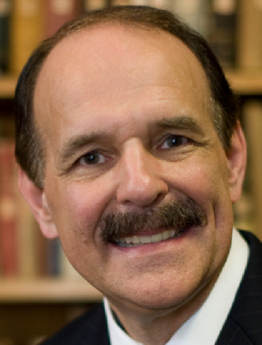
Christians will not reach perfection in this world, and we cannot escape the moral ambiguities and complexities that inevitably face us in a broken, sinful society. But within that world, we are called by God to a life of holiness and faithfulness that seeks to bear witness to God’s created order, the redemptive work in Christ, and Christ’s coming kingdom, when all things will be made new. Dennis P. Hollinger, Choosing the Good, 215

Slide 50
V. Conclusion:

Slide 51
Black

Slide 52
Worldview link at BibleStudyDownloads.org
Get this presentation for free!
Notes:
WV (Worldviews)

